Slide 1


ESPRESSO MACHINE INTERFACE
Phase 2 - Elaboration
GROUP NAME: CHAMPIONS -- GROUP NAME ON D2L = ICS 370-3
MEKDES GEBRECHRISTOS
SAMUEL KAREEM
DAVID HANG
DANIEL KOLLES
Notes:
Daniel
Summary -

Slide 2
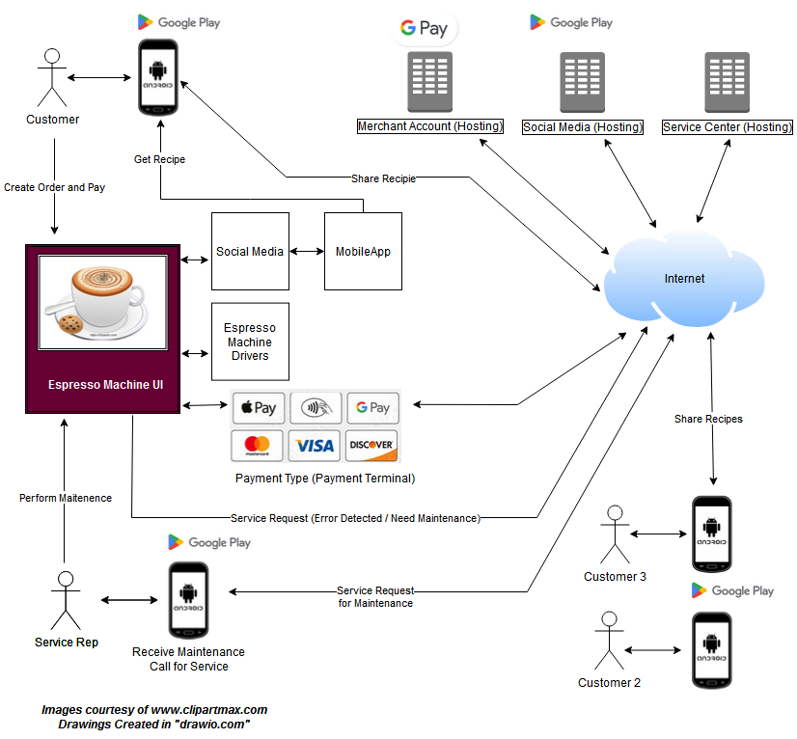
Context Diagram
‹#›
Notes:
Daniel

Slide 3
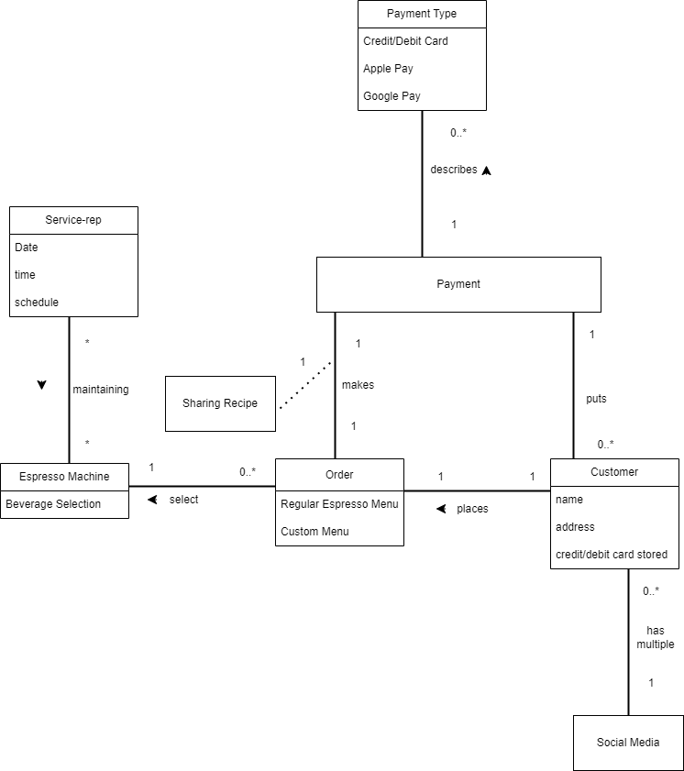
Domain Model
‹#›
Notes:
Mekdes

Slide 4
USE CASE # 1: Make Espresso Drink Selection
Success Conditions: Espresso Drink Selection is made, waiting for User to initiate brewing
‹#›
1. Espresso Machine Interface Requirements
1.1 If the start button is selected, the Espresso Machine (UI) shall display a menu with the following beverage selections. Each selection shall be a button.
Espresso Shots, Latte, Cappuccino, Americano, Macchiato, Flat White, Decafe
1.2 When customer selects beverage selection, an image shall be displayed
1.3 If customer selects drink size button, the Espresso Machine (UI) shall display drink size options
Short, Tall, Grande, Venti
1.4 If the customer selects a drink additive, the Espresso Machine (UI) shall display a menu of the following additive options. The customer shall be allowed to select 1 Milk option and a 1 Flavor option:
Milk
Dairy, Almond, Oat
Flavors
Vanilla, Caramel, Hazelnut
1.5 After the customer selects additive options, the Espresso Machine (UI) shall display the following brew options
Single shot, Double shot, Triple shot, Quad shot
1.6. If after the customer selects brew options, the Espresso Machine (UI) shall display a “Brew Now” message to customer
1.7 The Espresso Machine (UI) shall store the Espreso Selection, Drink Size, Drink Additive, and Brew options selected by the customer. (non-functional)
Notes:
Daniel

Slide 5
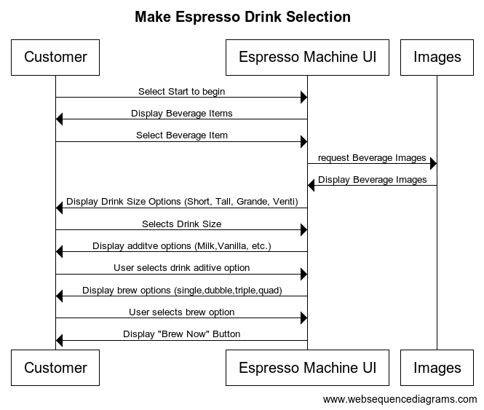
USE CASE # 1: Make Espresso Drink Selection
‹#›
System Sequence Diagram
Notes:
Daniel

Slide 6
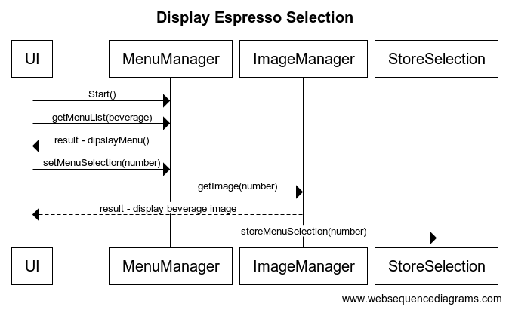
USE CASE # 1: Make Espresso Drink Selection
‹#›
Software Sequence Diagram
* * Storing the selections is related to non-functional requirement (1.7)
Notes:
Daniel

Slide 7
USE CASE # 2: Access Maintenance Cleaning
Success Conditions: Service-rep gain access to the maintenance menu, cleaning performed and test grind coffee before coffee is served to the customer
‹#›
2.1 The Espresso Machine (UI) shall display a Maintenance button
2.2 When the maintenance button is pressed, the Espresso Machine (UI) shall prompt for a security pin.
If no pin is entered after 10 seconds, the Espresso Machine (UI) will timeout and return to the main menu.
2.3 When the service rep enters invalid security pin, the Espresso Machine (UI) will clear the pin entry and prompt the message “Invalid Pin”.
2.4 When the service rep enters a valid security pin, the Espresso Machine (UI) shall display the Maintenance Menu
2.5 When the Mobile App displays the maintenance menu, service-rep would press the cleaning button.
2.6 The Espresso Machine (UI) starts the cleaning process, and the Mobile App displays a message once the cleaning is performed.
2.7 The Espresso Machine (UI) shall display the coffee menu after it is done cleaning.
2.8 When service-rep presses the brew button to test grind, the coffee maker will start to brew a single shot of espresso.
2.9 When Brewing is complete, the Espresso Machine UI shall display a message “Coffee is Ready” and “Test Brew Complete”
Notes:
Mekdes

Slide 8
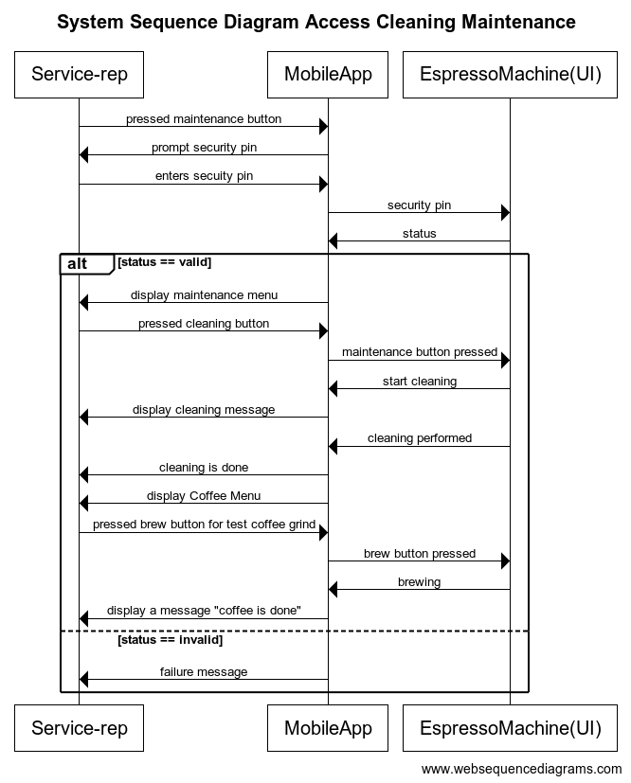
Use Case #2 Access Maintenance
‹#›
System Sequence Diagram
Notes:
Mekdes

Slide 9
USE CASE # 3: Customer Access social media through Mobile App
Preconditions - QR Code is accessible on the Espresso Machine UI
Success Conditions: Customer has access to the social media and ready to share recipe once the type of beverage is selected
‹#›
Customer accessing Social Media through Mobile App
3.1 The Mobile app shall support the ability to sign in with username and password.
3.2 When the customer goes to the mobile app, it prompts to the login page, then the customer puts their credentials.
3.3 When a customer scans a QR code on the Espresso Machine (UI), the Mobile App shall prompt the customer to share.
3.4 When the customer clicks on the share button, the social media message displays a “share recipe” posted.
3.5 Once the recipe is shared on social media, then the mobile app informs the customer that the recipe can be viewed by others.
3.6 The Mobile App shall allow customers to comment on the shared recipes.
Notes:
Mekdes

Slide 10
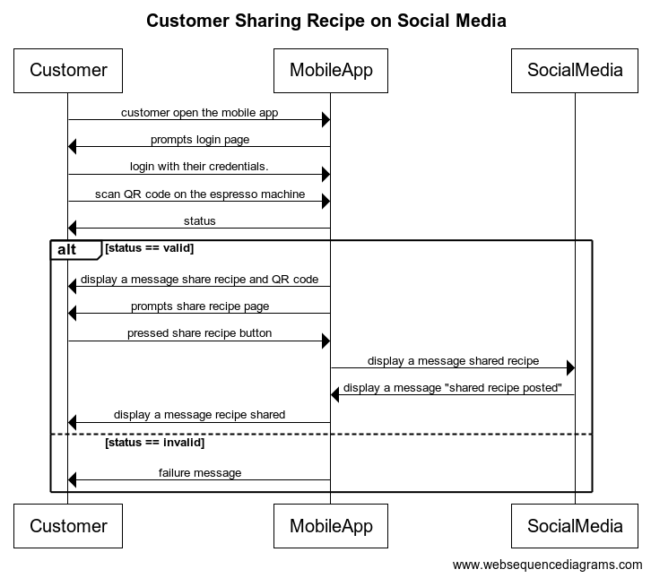
Use Case #3: Customer Access social media through Mobile App
Sequence Diagram:
‹#›
Notes:
Mekdes

Slide 11
USE CASE # 4: Place Order Payment
Success Conditions: Customer has proceed their order and waiting to brew with their order
‹#›
Payment interface Requirements
4.1 If the customer has completed all selection options for the espresso beverage, the Espresso Machine (UI) shall display the “Check Out” button
4.2 If customer selected to “Check Out” button, the Espresso Machine (UI) shall display the following payment options for the User to select:
Credit card/Debit card (Discover, Visa, Master Card, Amex)
Google pay
Apple pay
4.3 When the customer selects on payment of choice the Espresso Machine (UI) shall display the total amount due, the Espresso Machine (UI) shall display the “Pay Now Button”.
4.4 If an invalid payment is processed at the terminal, the Espresso Machine (UI) shall display “Error.. .try again”
4.5 If a valid payment action is processed, the Espresso Machine (UI) shall display order details and the “Brew Now” button.
Notes:
David

Slide 12
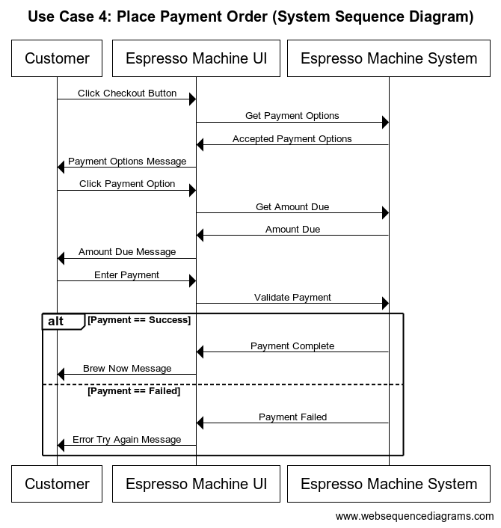
Use Case #4 Place Order Payment
‹#›
System Sequence Diagram
Notes:
David

Slide 13
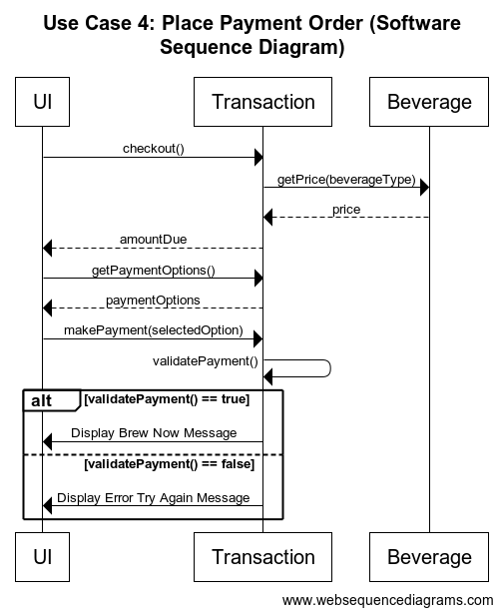
Use Case #4 Place Order Payment
‹#›
Software Sequence Diagram
Notes:
David

Slide 14
USE CASE # 5: Create Beverage
Success Conditions: Espresso Machine (UI) completes brewing order and beverage is ready for the Customer
‹#›
Access Payment Requirements
5.1 If the customer has pressed the “Brew Now” button the Espresso Machine (UI) shall commence brewing and display the message “Brewing… ”.
5.2 While the Espresso Machine (UI) is brewing the beverage, the Espresso Machine (UI) shall display an image of the ordered beverage
5.3 Upon completion of the brewing process, the Espresso Machine (UI) shall beep an alarm and display the message “Your beverage is ready”
Notes:
David

Slide 15
USE CASE # 6: Custom Menu
Success Conditions: Customer creates their special beverage and is ready to share
‹#›
Custom Menu Interface
6.1 When customer selects custom button, the Espresso Machine (UI) shall display a list of drink additive which included the following:
Milk
Dairy, Almond, Oat
Flavors
cinnamon Dolce, Eggnog, Peppermint, Pumpkin spice,,Caramel Brulee,Mocha,White Chocolate Mo
(The customer shall be allowed to select more than one additive)
6.2 After the customer selects additive options, the Espresso Machine (UI) shall display the following brew options
Short, Tall, Grande, Venti
6..3 After the customer selects brew options, the Espresso Machine (UI) shall display a “Brew Now” message to customer and “Social”
Notes:
Mekdes

Slide 16
USE CASE # 7: Share Recipe
Preconditions - Customer is ready to commence brewing of drink
Success Conditions: Customer is successful in sharing the special beverage recipe
‹#›
Share Recipe
7.1. After the customer selects the “Brew Now” button, Brewing of the drink shall commence.
7.2 When the customer selects the “Brew Now” button, a QR code with the message “Share Recipe” shall be presented.
(** Note, the QR code represents the drink recipe **).
7.3 Using the Mobile App, the customer shall have the ability to share the beverage recipe by scanning the QR code.
Notes:
Mekdes

Slide 17
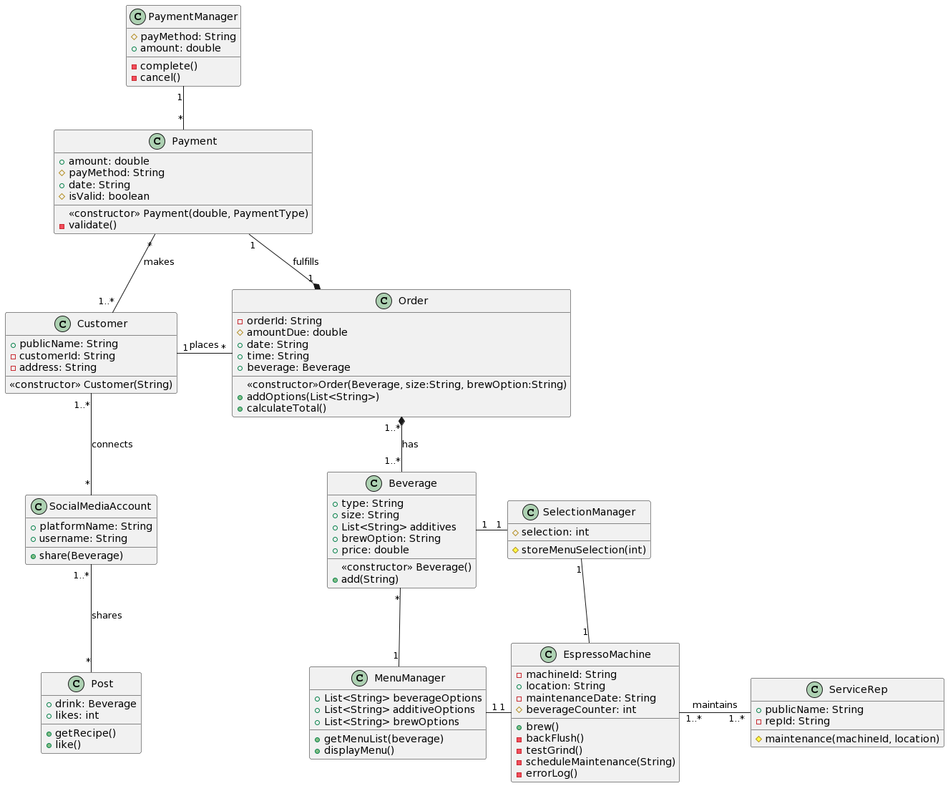
Class Diagram
‹#›
Notes:
David

Slide 18
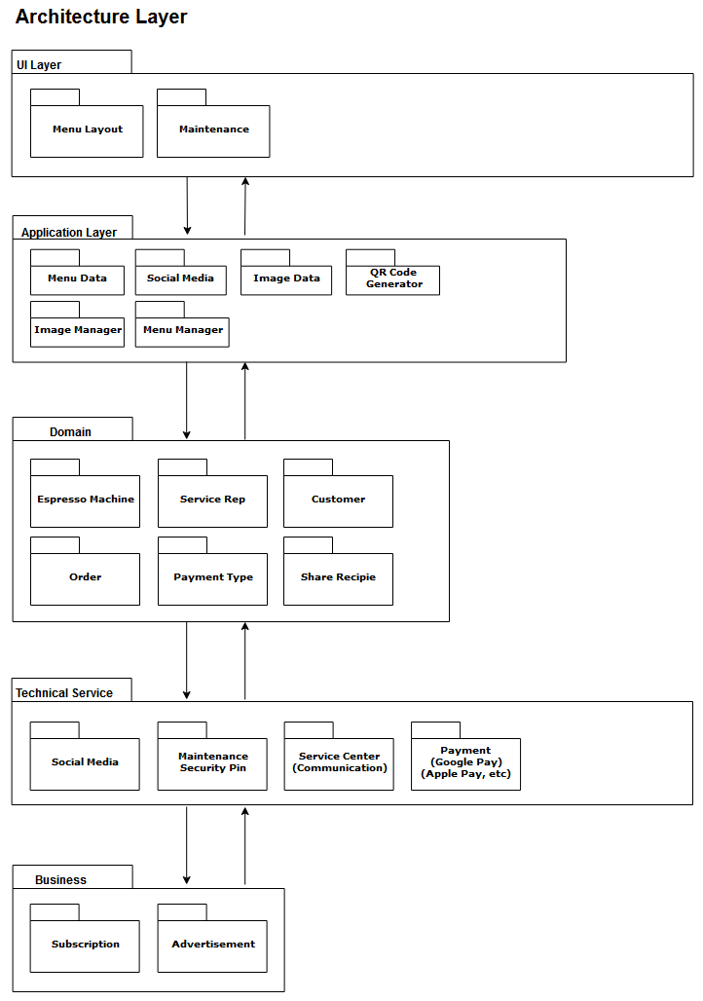
Architecture Layer
‹#›
Notes:
David

Slide 19
Other Non-Functional Requirements
‹#›
Performance:
8.1 The software have a response time of 1000 ms or less rendering text and images to the display (e.g. displaying menus).
Usability:
8.2 The software shall display images of specialty of espresso drink selections
Reliability:
8.3 The software shall maintain optimal performance and response of 98% without critical failure. Any errors detected shall be logged to NVM.
Compatibility:
8.4 The software shall support and render without modification on table devices running Android versions 12 or newer.
Supportability:
8.5 The software shall support the ability to log system errors.
Notes:
Daniel

Slide 20
Project Risks & Mitigation
‹#›
Mitigation:
Decided on using only Android instead of supporting both iOS and Android platforms. This will minimize the complexities associated with support, cost, and development.
Risks:
No new risks
Same risks identified in Inception Phase are still applicable.
Notes:
Daniel

Slide 21
DEMO
‹#›
Notes:
Samuel

